Slide 1





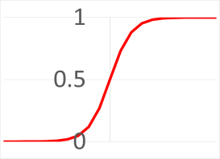









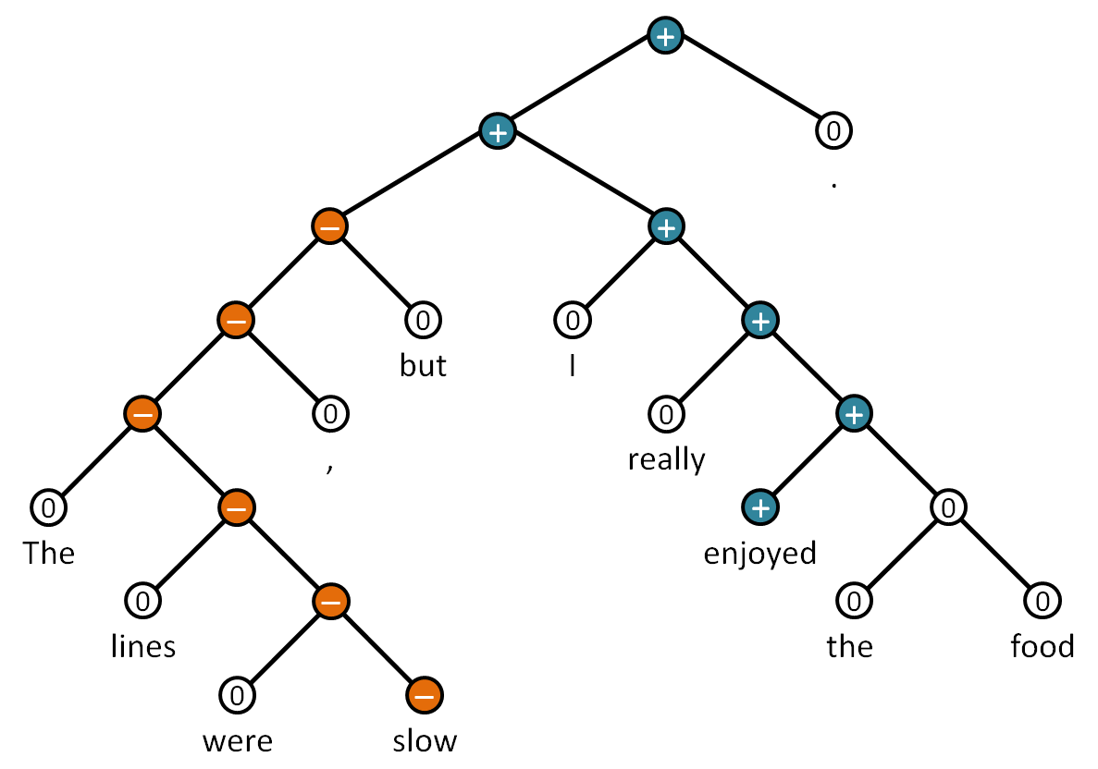

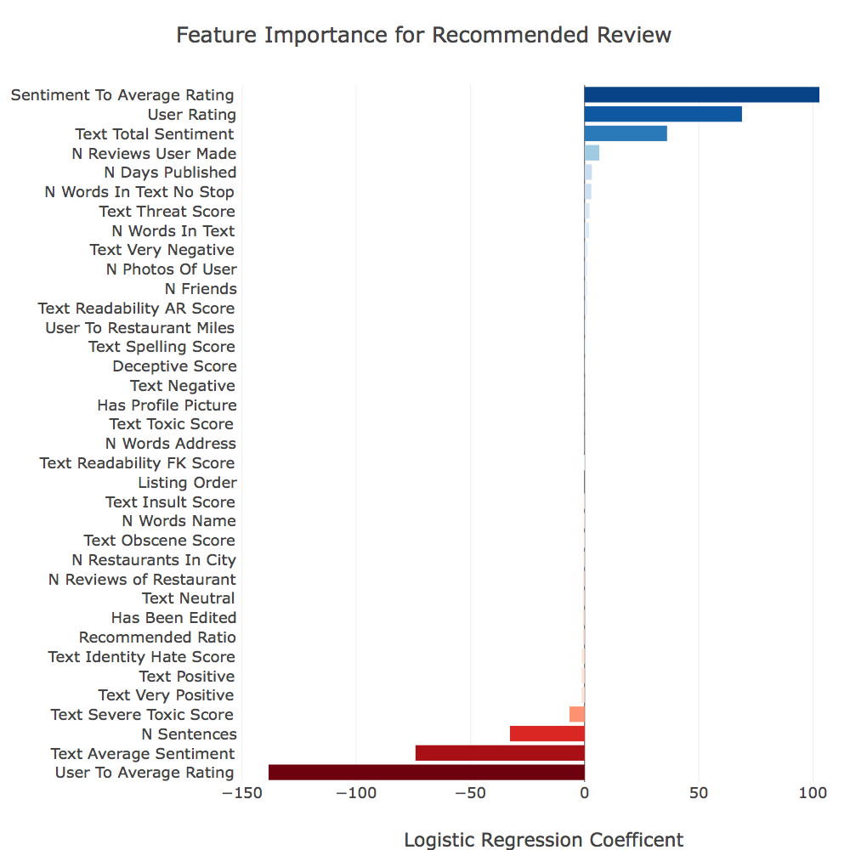
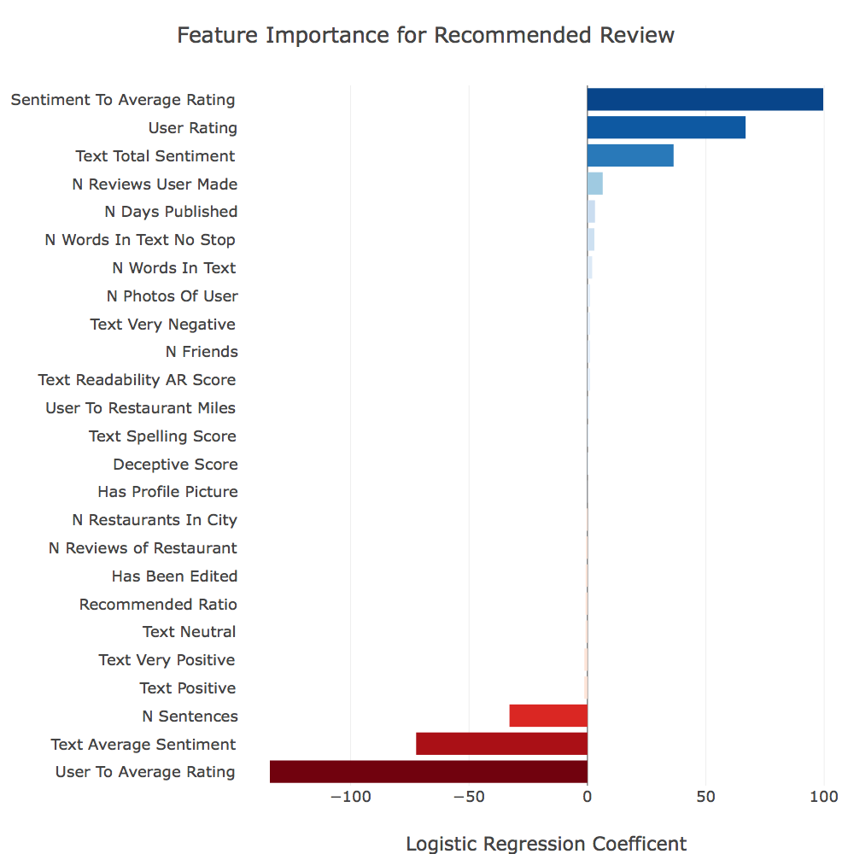

Yelp’s Review Filtering Algorithm
Yao Yao, Ivelin Angelov, Jack Rasmus-Vorrath, Mooyoung Lee, Daniel W Engels
Master of Science in Data Science
Southern Methodist University, Dallas, TX 75275, USA
Yelp
Data Scraping | Feature Creation | Modeling
Multivariate Logistic Regression
Online third-party crowd-sourced platform for:
Users seeking and submitting advice
Businesses seeking feedback and advertising
Reviews with 1-to-5 star ratings and written text
155 million total reviews include: 72% recommended, 21% not recommended, and 7% removed
157 Cities
676 Restaurants
347,817 Reviews
One unified model for binary prediction
Features created from metadata:
Converted into numerical
Adjusted for distribution asymmetry
Scaled from 0 to 1
Direct comparisons
Coefficients measure feature importance
Pre-balancing the dataset to 50:50:
Equal emphasis for predicting both review types
f(Restaurant, User)
NLP Sentiment
Balance & Scale
Logistic Regression
p
Proportional subgroup: data consistency
1) Cluster: Sample cities that adopt Yelp
2) Stratify: Sample restaurants from cluster
Spelling & Readability
Deceptive & Extreme Text Classifiers
Final Model
Feature Selection
Motivation
Recursive tree structure: Fragments and uses grammar rules to find tonality of nested phrases steming from individual words
Algorithms can inherently have unethical procedures when filtering out reviews
Yelp filters reviews to:
Promote quality and reliable information
Help consumers gain insight and make decisions
Reduce deceptive, disruptive, and paid reviews
Naive Bayes | Label | The | Place | Is | Good | Bad
The place is good. | 1 | 1 | 1 | 1 | 1 | 0
The place is bad. | 0 | 1 | 1 | 1 | 0 | 1
p(label=1) | 0.5 | 0.5 | 1 | 1 | 1 | 0
p(label=0) | 0.5 | 0.5 | 1 | 1 | 0 | 1
Guideline For Recommended Review
Bag of words: Does not check grammar or word order. Trains words with larger difference in occurrence to classify as labels
Submit for: businesses with less reviews
Rate: Critically
Write: Concise overall positive message that express variations in sentiment. Use mild complexity and less common words
Accumulate: Friends, Total reviews, Total photos, Recent reviews
Update reviews: Less
Text Classifier | Observations | Precision | Recall | F1-Score
Toxic | 15,294 | 0.96 | 0.96 | 0.96
Severely Toxic | 1,595 | 0.99 | 0.99 | 0.99
Obscene | 8,449 | 0.98 | 0.98 | 0.98
Threat | 478 | 1 | 1 | 1
Insult | 7,877 | 0.97 | 0.97 | 0.97
Identity Hate | 1,405 | 0.99 | 0.99 | 0.99
Deceptive | 800 | 0.88 | 0.88 | 0.88
Problem
Yelp's filtering algorithm can misclassify:
Credible reviews as not recommended
Deceptive reviews as recommended
Final Model: Insignificant features by p-value are removed
Model | Observations | Precision | Recall | F1-Score
Full | 53,330 | 0.80 | 0.74 | 0.77
Reduced | 53,330 | 0.79 | 0.74 | 0.77
Reduced Model | Predicted Not Recommended | Predicted Recommended
Actual Not Recommended | 21639 | 5026
Actual Recommended | 6913 | 19752
Ethics
Yelp’s Filtering Algorithm
Pooling information towards general consensus: makes Yelp less likely to be wrong and is a justified reflection of the collective experience
Yelp filters for: Concise and useful information, removal of less credible information
Dependent on the end user: To take advice from Yelp and to make better informed decisions
Only recommended reviews calculate average rating
Recommended reviews and average ratings:
Influence consumer decisions and business revenue
Not recommended reviews are:
Purchased, bribed, social/political protest, not credible, unrelated, and not understandable
Still accessible, does not censor free speech
Can be recommended when algorithm changes
Reviews are removed by:
Violating Terms of Service and defamation court rulings
Filtering algorithm is undisclosed:
Prevent manipulating the system
(Full Model)
(Reduced Model)
Conclusions
Yelp’s filtering algorithm promotes: Critical ratings, Genuine reviews, Quality of text (Complexity and Less common words), Reliability of content (Recent reviews and more submitted data activity), Insight (Variation of sentimental context and Collective experience)
Consumers' decisions based on: Personal discretion
The filtered reviews and average rating: Justified reflection of the collective experience

